Slide 1

O-go application

Slide 2
Introduction

Slide 3
Objectives
A
L
Less waiting in restaurants
Avoid eating at crowded restaurants
K
A
Keep up with 2030 vision
Automated order processing

Slide 4
Phases
Initiaion
Designing
Planning and analysis
Development
Testing
Closure

Slide 5
App features
Traking orders
Avoid crowded
Rewards and slases
Speeds operations

Slide 6
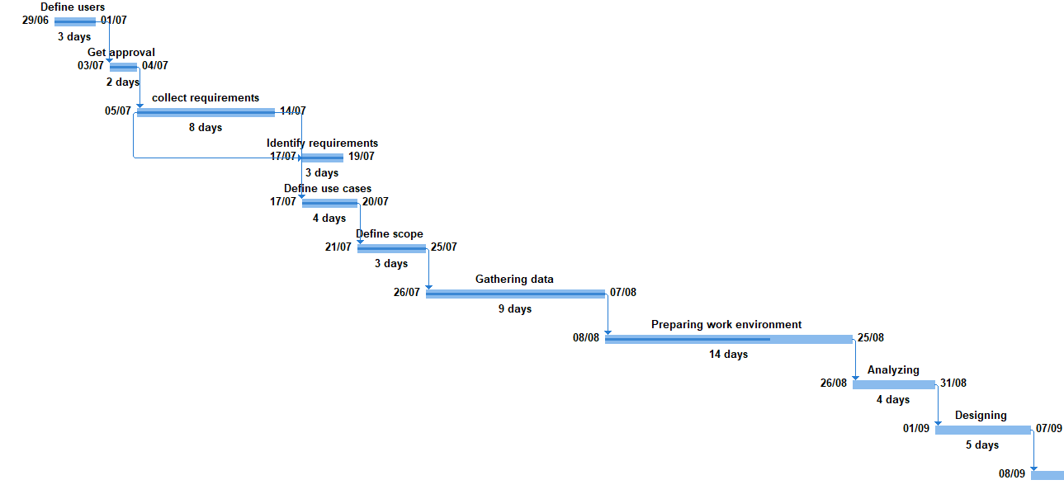
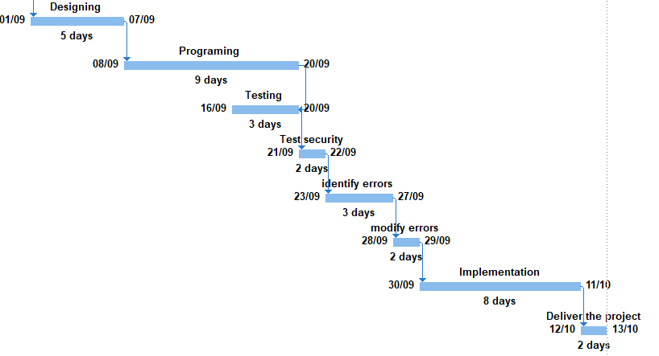
Gantt Chart
Task links
From collect requirements to identify requirements is (SS).
From programing to testing is (FF).
From identify errors to modify errors is (FS)

Slide 7
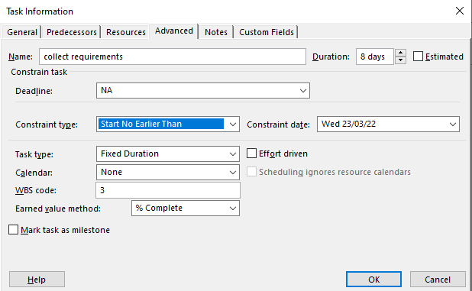
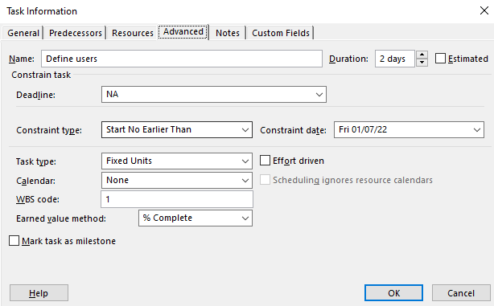
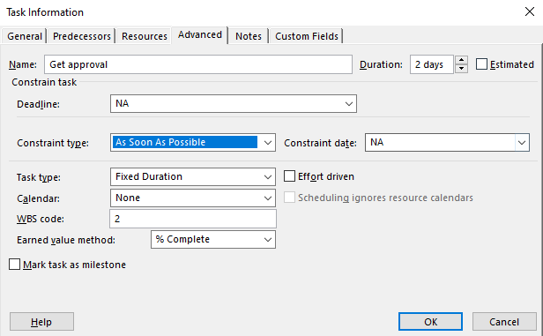
Gantt Chart
Constrains:
As soon as possible:
Start no earlier than:
Finish No Earlier Than:

Slide 8
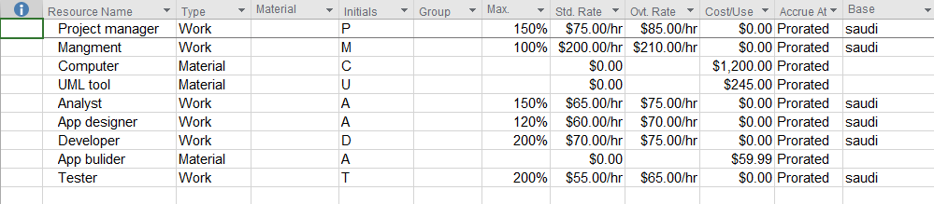
Resource sheet

Slide 9
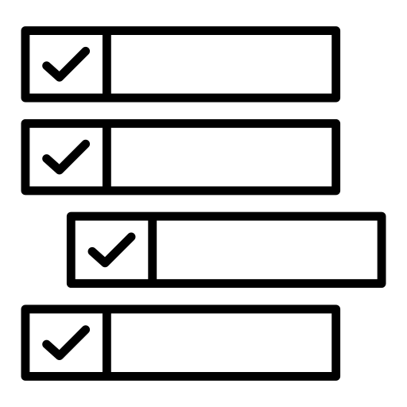
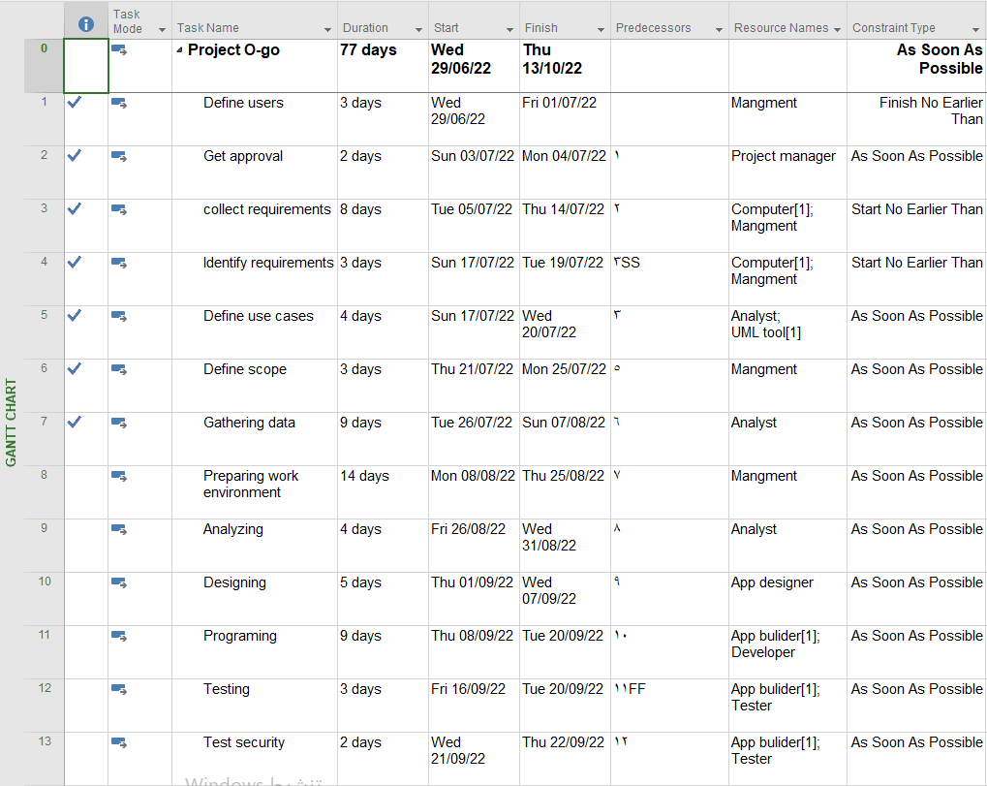
Resource task assignment

Slide 10
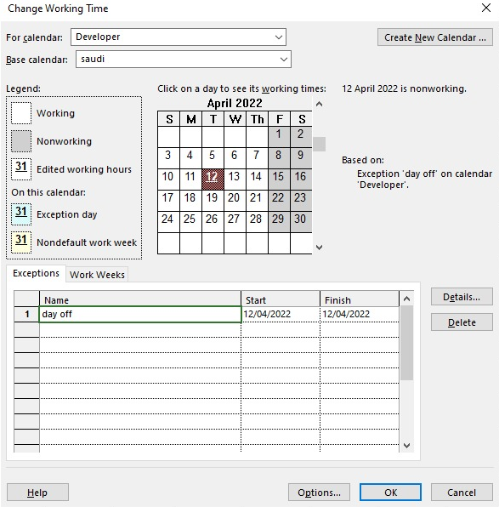
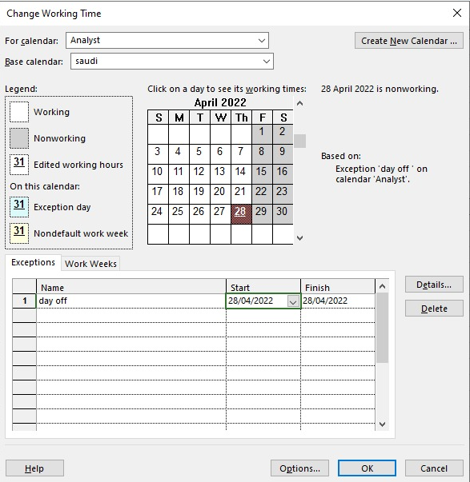
Calendars
Developer 's calendar
Analyst 's calendar

Slide 11
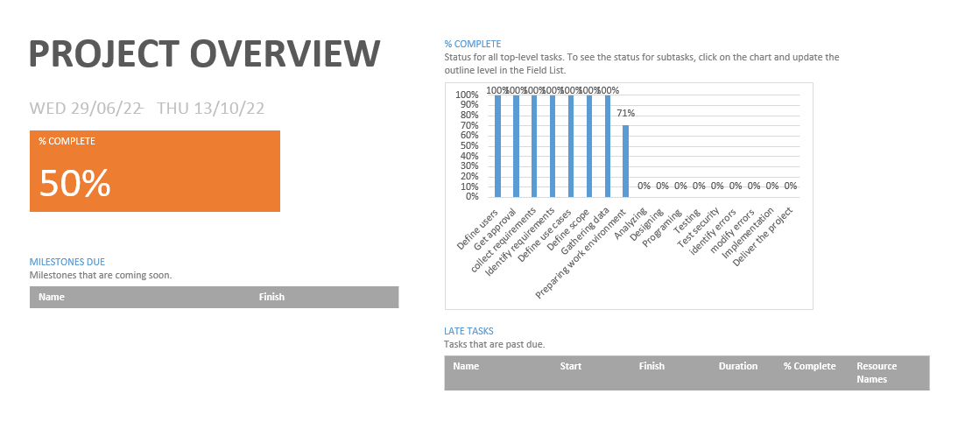
Statistics

Slide 12
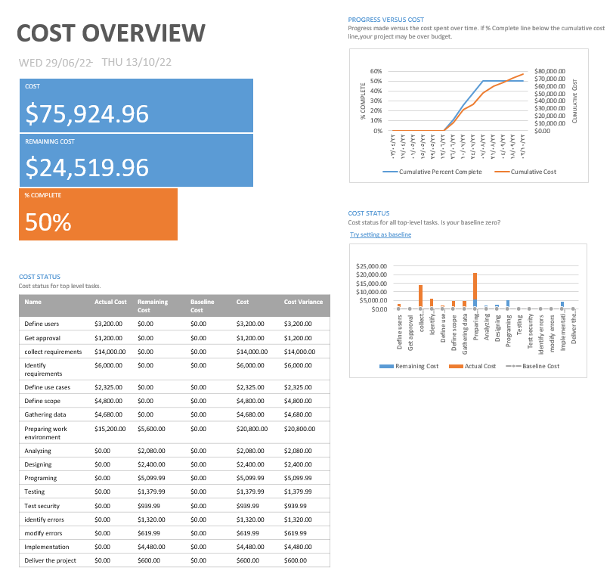
Statistics

Slide 13
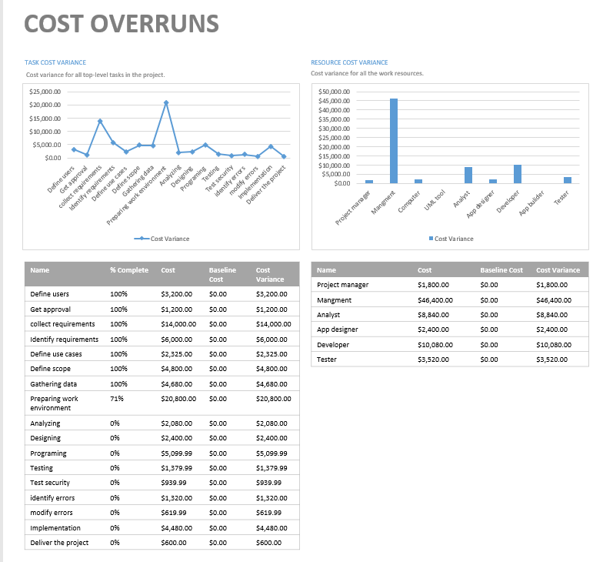
Statistics

Slide 14
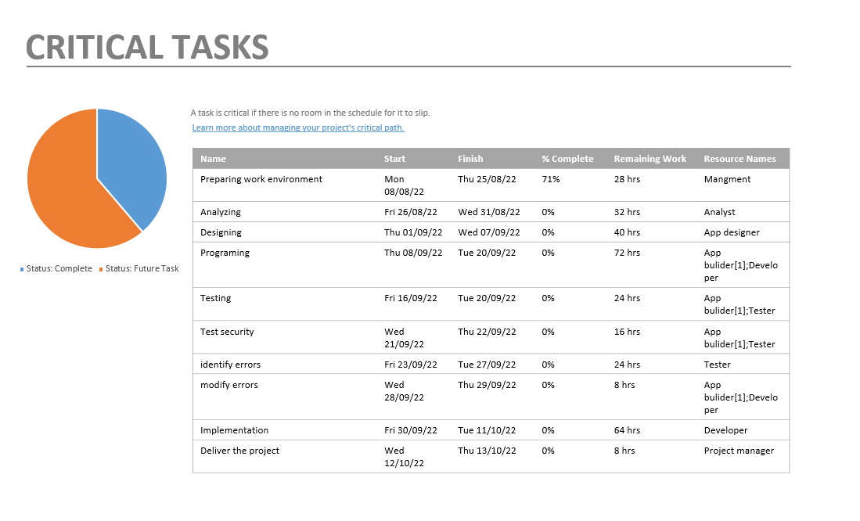
Statistics

Slide 15
Thank you for listening

